Slide 1
Car Price Prediction
Prof. Hamidrez Ahady Dolatsara
Ban 5600: Advanced Big Data Computing and Programming
Tyler Rappaport, Yanjing Wang, Ziru Wang

Slide 2
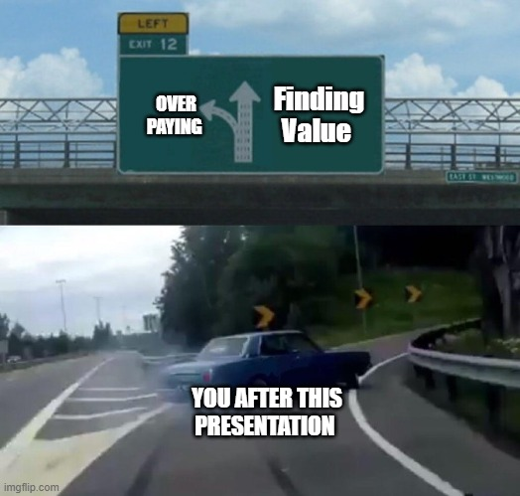
Table of Contents
Project Foundation
Narrative Background
Dataset Introduction
Coding Environment Platforms
Data Visuals
Predictive Analysis
Linear Regression
Random Forest
Stacked Ensemble
Data Conclusions
Business Suggestions and Retrospective

Slide 3

Project Foundation
Methodology / Set up
We are assuming the role of a third party Analysis for the automobile industry
Ever present questions of ‘What is a fair price for a car?’ and ‘How much more is a new car worth?’
Goals
Predicting the price of cars based on the available factors, and determine which are significant
Giving both buyers and sellers a reference point in the car market

Slide 4

Narrative Foundation
Automobile Industry had 66.7 million units sold in 2021, used cars largest segment
High asymmetry from brand, year made, condition (new vs totaled), and model features
Car buyers covers many archetypes and purchasing powers

Slide 5
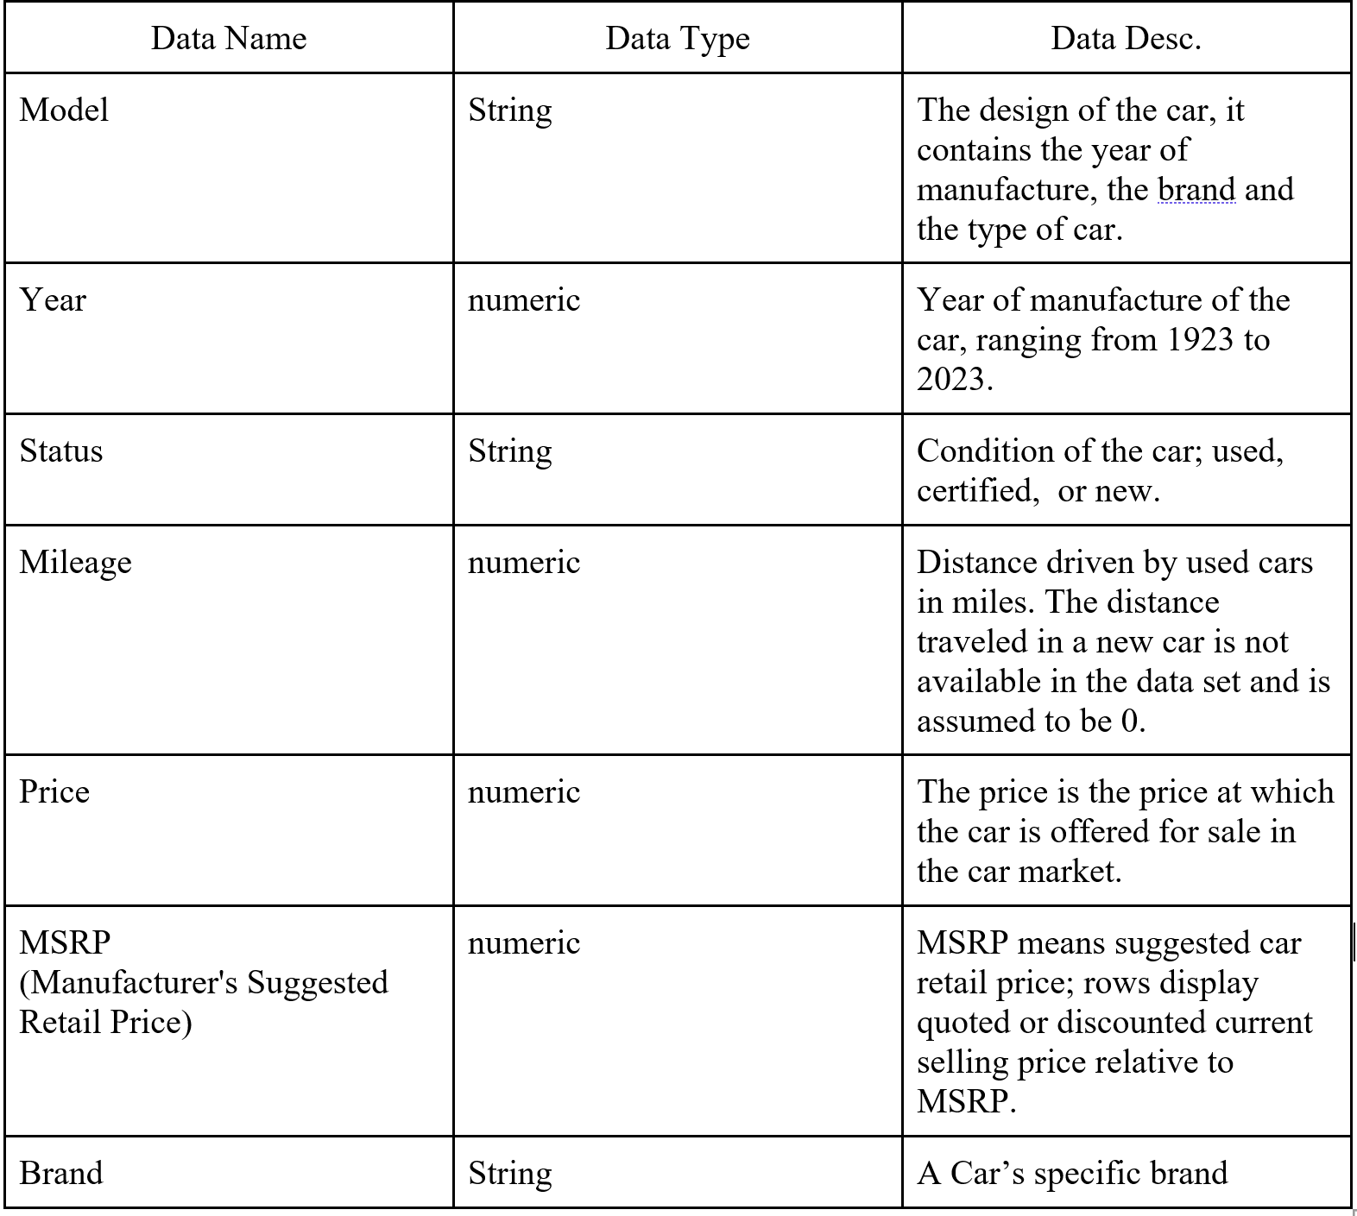
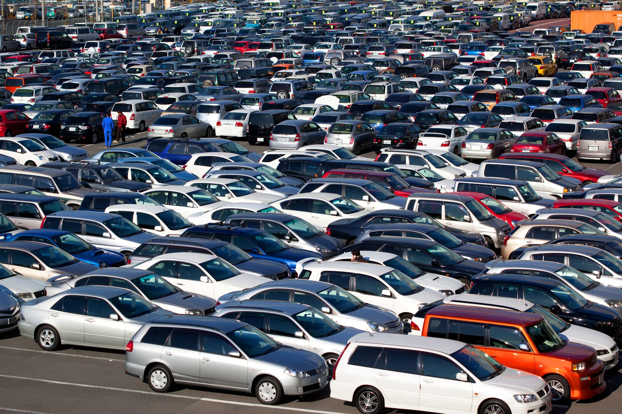
Dataset Introduction
The kaggle dataset on Cars contains vehicles made from 1949-2023
Price will be our dependent variable
There are over 115k cars in the observation, with an industry reflective variety of brands and segmentations
Mileage will act a gauge of condition (I.E. a high Mileage = a worse condition)

Slide 6















Slide 7
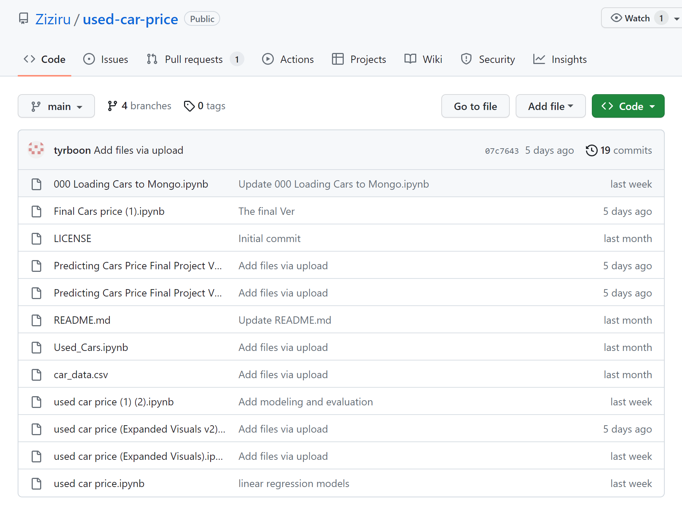



Coding Environment Platform
The code was generated in .ipynb files using Pyspark. This code can be run on Databricks and on Google Cloud with a Pyspark environment capable of running Hadoop and Yarn.
We shared the code on GitHub and cleaned the dataset.

Slide 8
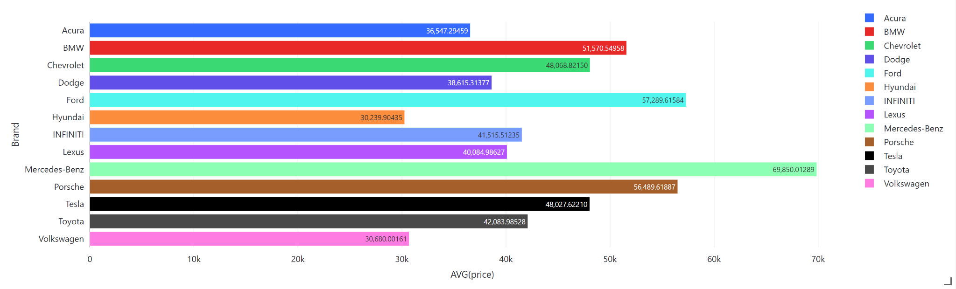
Data Visuals a. Brand Avg. Price
# Labels show Obsv. Count

Slide 9
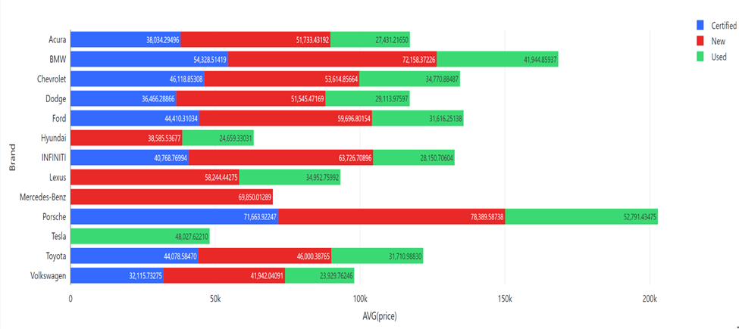
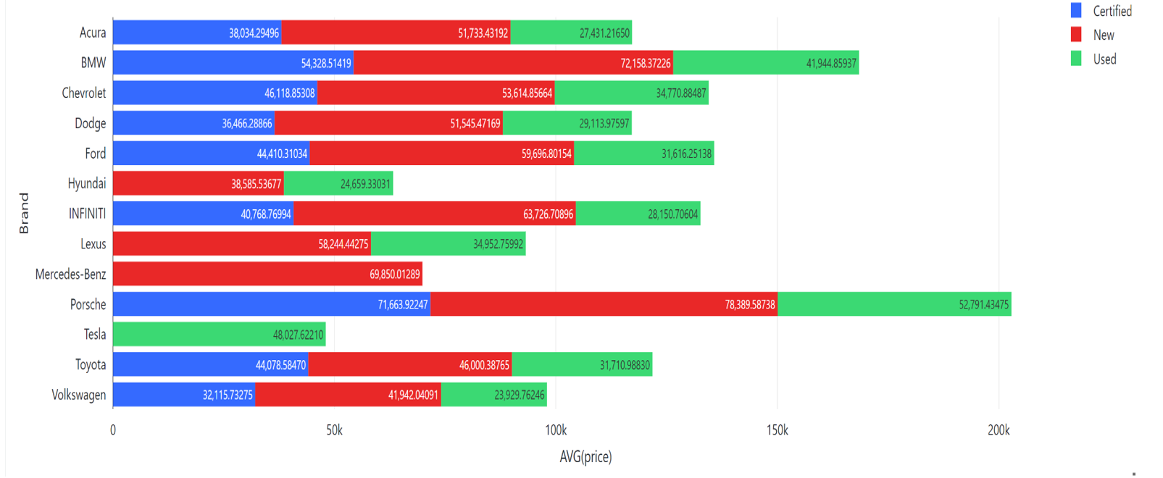
Data Visuals b. Brand Avg. Price by Status
# Labels show Avg. Price

Slide 10
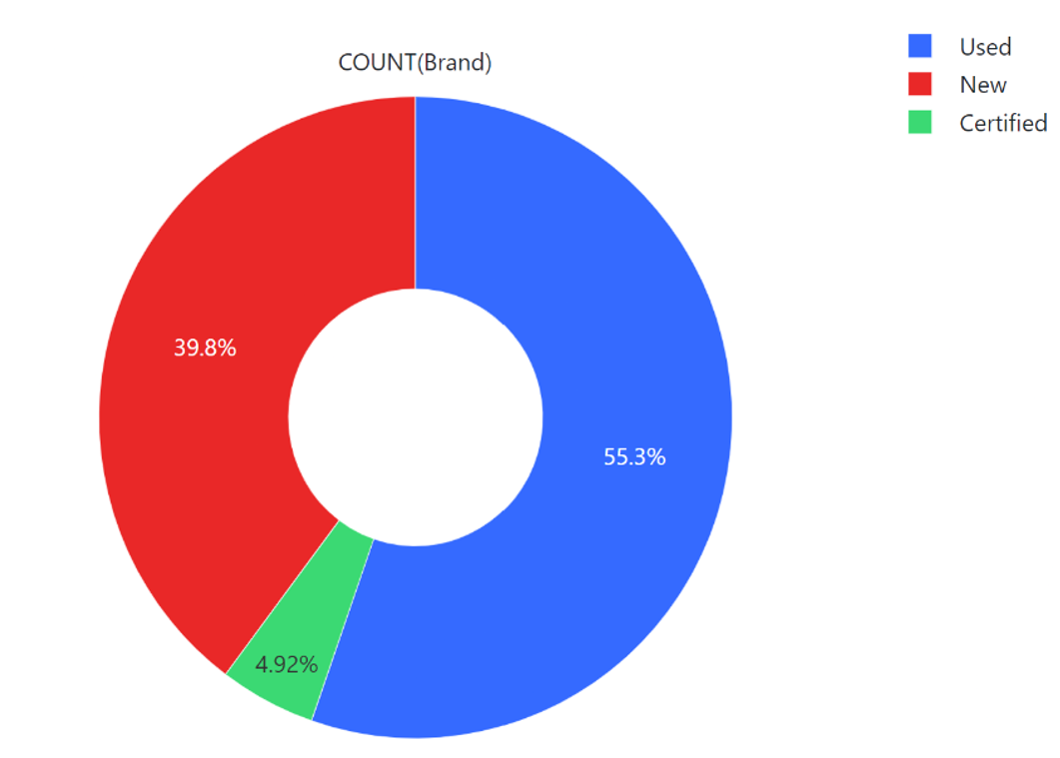

Data Visuals c. Status Market Segmentation
New Cars= 42,514
Used Cars= 59,139
Certified Cars= 5,258

Slide 11
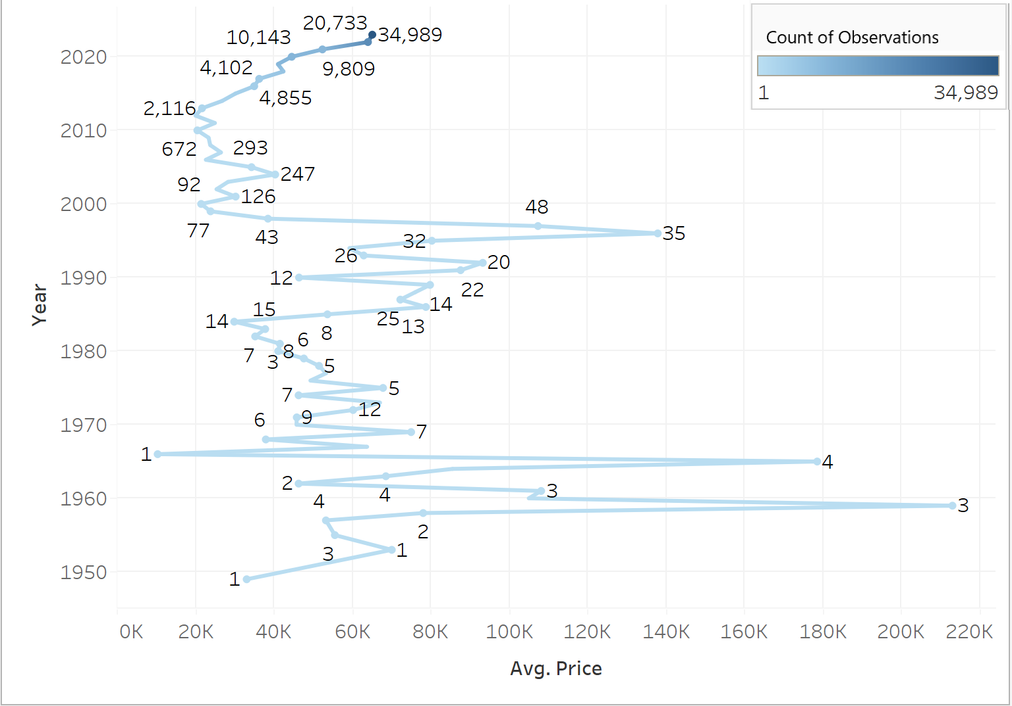
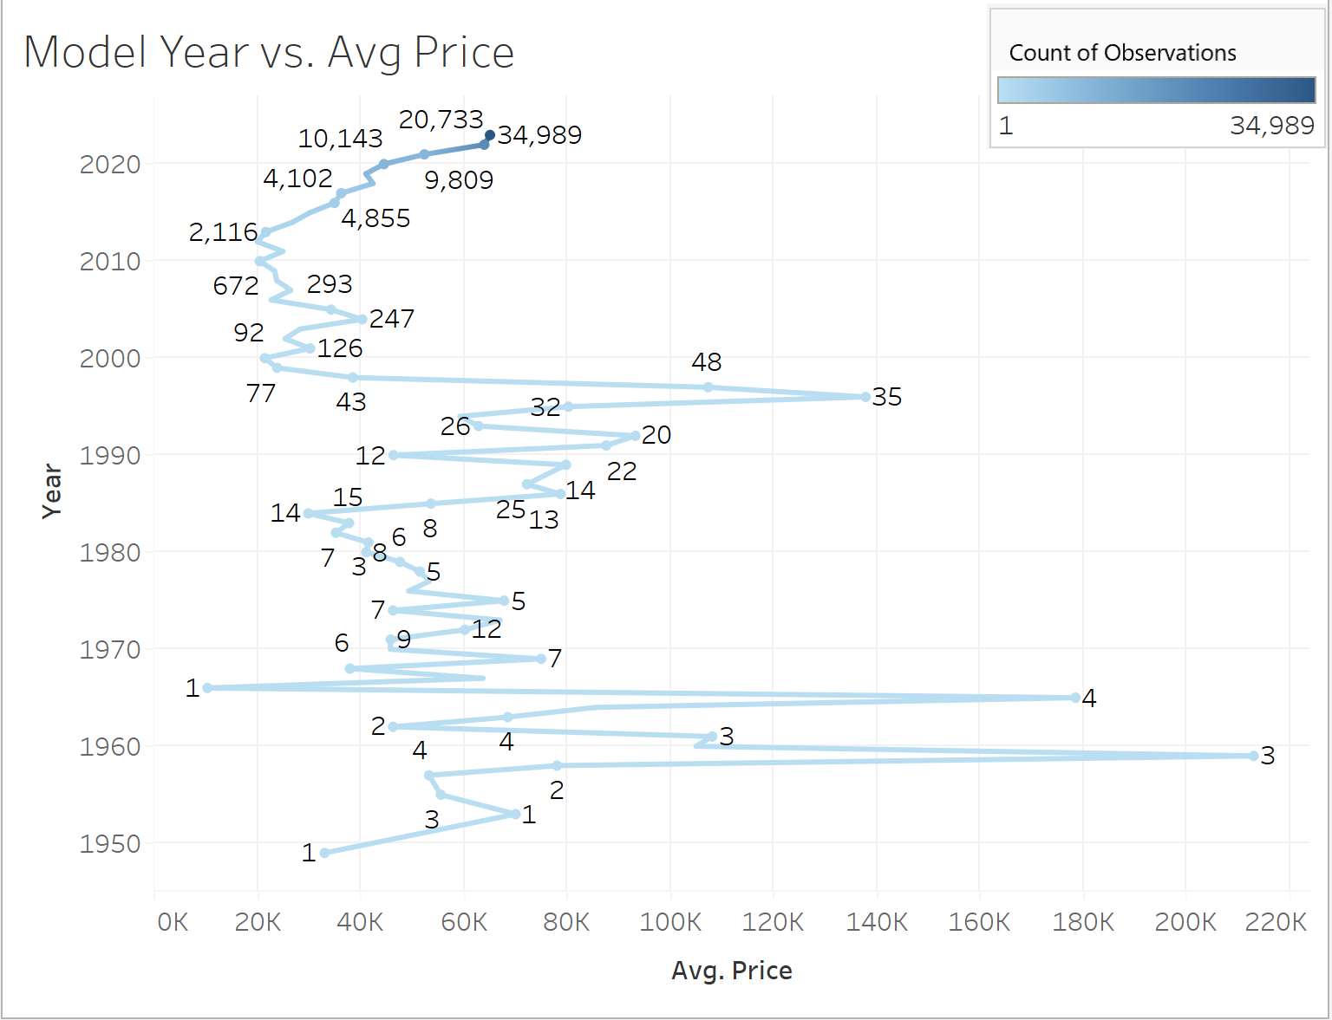
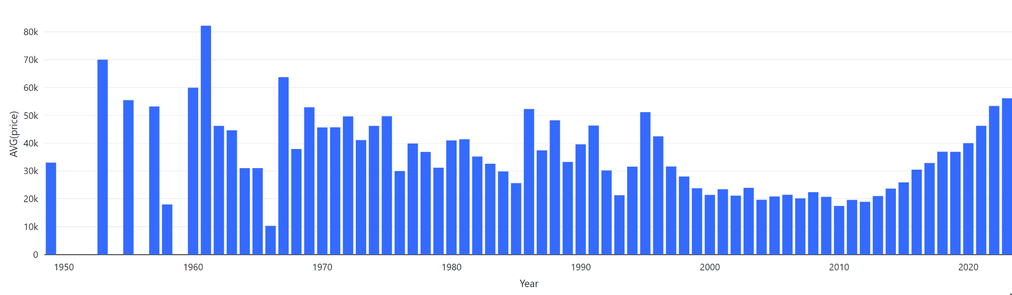
Data Visuals d. Model year vs. Avg. Price

Slide 12
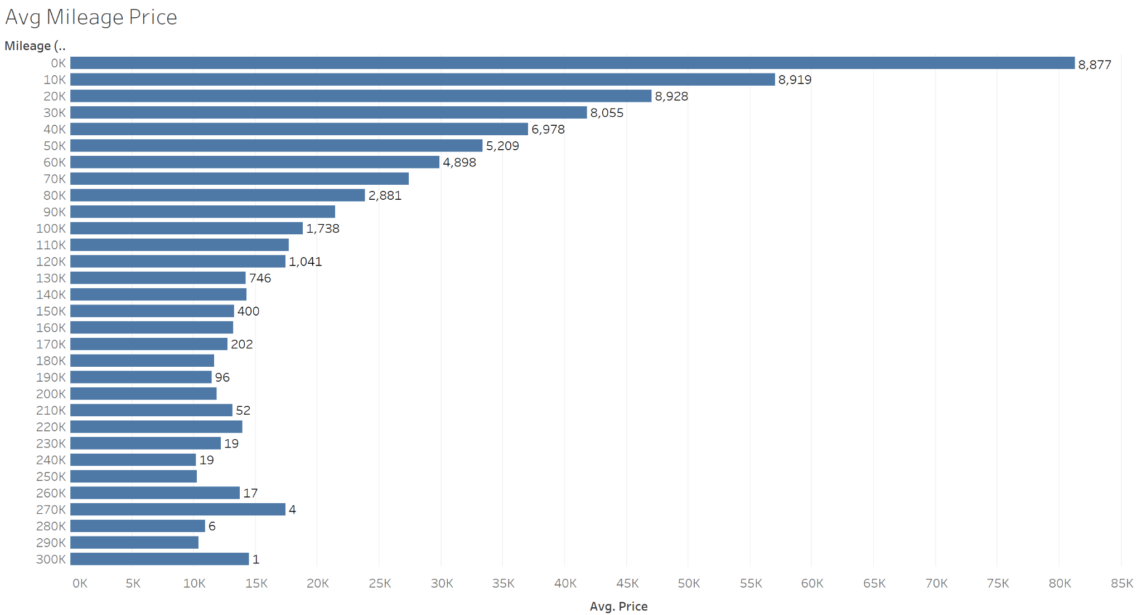
Data Visuals e. Mileage vs. Avg. Price
# Labels show Obsv. Count

Slide 13
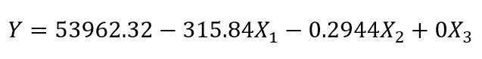
Data Analysis a. Linear Regression
 | Coefficient
Intercept | 53962.32
Age | -315.84
Mileage | -0.2944
Status | 0
RMSE= 16657
R^2 = 0.357
To improve the interpretation of linear regression and the accuracy of the model, we continued to fit the training data using a multinomial regression model.
RMSE= 16452
R^2 = 0.382
The results of the linear regression model were not satisfactory as now the model explained 38% of the rate of change of the dependent variable, which while still an improvement still left many open questions. Given this, it can be said that there was no linear relationship between the status and the dependent variable.

Slide 14
Data Analysis b. Random Forest
Pipeline Model Transformer
Cleaned-data
Mapped string to a value
Feature Vectors
Prediction
Pipeline Model .transformer()
StringIndexer
VectorAssembler
Random Forest

Slide 15
Data Analysis b. con…
Prediction Result
Feature Importance
RMSE | 10806.7
R-squared | 0.729684
Model | 0.6690082108804108
Mileage | 0.0910190390098326
Brand | 0.0841503414764426
Status | 0.07792579806397547
Year | 0.0778966105693384
The prediction accuracy of the random forest model is 72.9%.
The most Importance factor is the car model, followed by the mileage, then the brand, status, and year.

Slide 16


Data Analysis c. Stacked Ensemble - H2O
H2O is an open-source machine learning platform that provides scalable and easy-to-use tools for data analysis and modeling.
It allows users to build and deploy machine learning models in various settings, from single machines to large clusters and cloud environments.
Compared to Spark, H2O Machine Learning provides a more streamlined and user-friendly interface with built-in algorithms and visualizations.

Slide 17
Data Analysis c. con…
Basic Model -1
Basic Model -2
Raw data
New Training Data
Meta-Model
Prediction
Basic Model -3
Basic Model …

Slide 18
Data Analysis c. con…
Number of base models | 2
base models | GBM, XGB
Metalearner algorithm | GLM
Metalearner nfolds | 0
In basic model, we use Gradient Boost Model and XGboost
In the metamodel, we use GLM algorithm to stacking the base model
MSE | 71310487.5334
RMSE | 8444.5537
MAE | 5482.7194
R-squared | 0.8277
The model prediction accuracy is 82.7%, which is the best performance among all our models

Slide 19
Data Analysis c. con…
variable | scaled_importance | percentage
Mileage | 1.0 | 0.4377605
Year | 0.2639411 | 0.1155430
Brand.Porsche | 0.1560046 | 0.0682927
--- | --- | ---
Status.Certified | 0.0000262 | 0.0000115
Model.2016 Volkswagen Passat 2.5L S | 0.0000117 | 0.0000051
In this model, the importance of all string-class variables is calculated independently so that mileage is the most important factor, followed by year, and status
Summing up all car models' importance, the model importance is still the most important factor. It does not conflict with the results of the random forest model

Slide 20
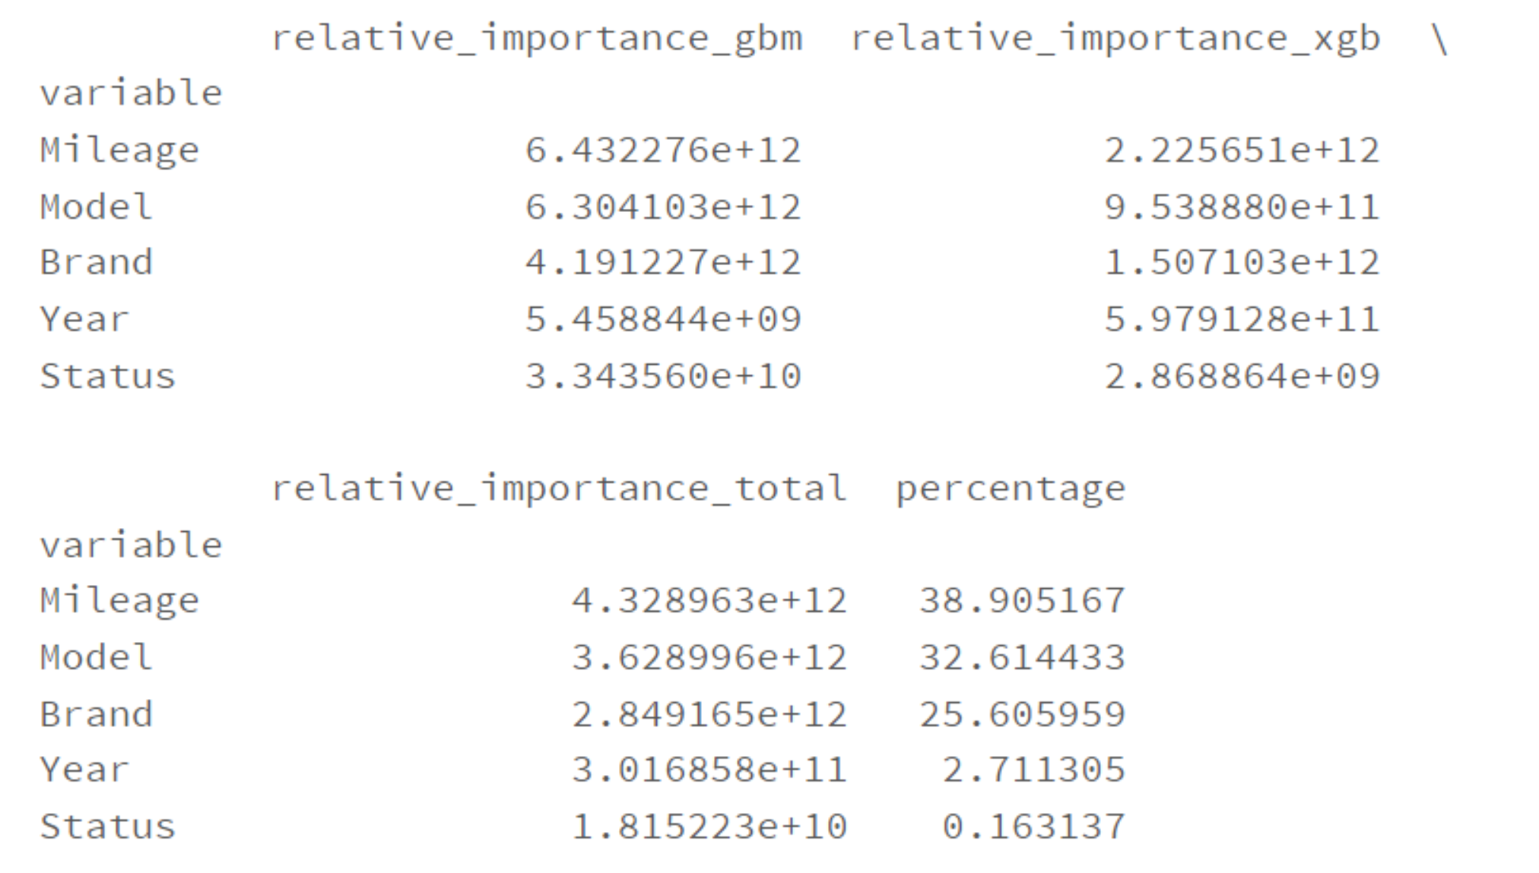
Data Analysis c. con…
variable | scaled_importance | percentage
Mileage | 1.0 | 0.4377605
Year | 0.2639411 | 0.1155430
Brand.Porsche | 0.1560046 | 0.0682927
--- | --- | ---
Status.Certified | 0.0000262 | 0.0000115
Model.2016 Volkswagen Passat 2.5L S | 0.0000117 | 0.0000051
The importance scores in GBM and XGB are compared, with factors like Model amd Brands weighted as a group. The Average importance was then found between the models
On Average, Mileage was the most Important, and Status was the least important.

Slide 21
Data Conclusions
A car’s brand effects price (Market segmentation and differing brand valuation/loyalty)
Status is not a significant factor, but it can imply other relevant factors, (I.E. condition)
Higher Mileage correlated to a lower price
Older Models generally sold for less, but there were exceptions (collectors items)

Slide 22
Business recommendations and retrospective
Our Stacked Ensemble model is strong enough to give a reference point
Brands matters
A car’s features need to be the focus when estimating value (The label of ‘Used-car’ is not enough)
Cars can be a store of value, but are likewise depreciating assets
It would be interesting to take model specific details into account (Safety rating, Backup camera)
Being able to have the cars exact conditions would create a stronger model

Slide 23
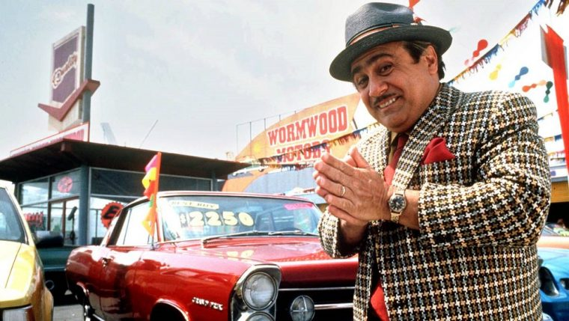
Thank You!!!

